Slide 1

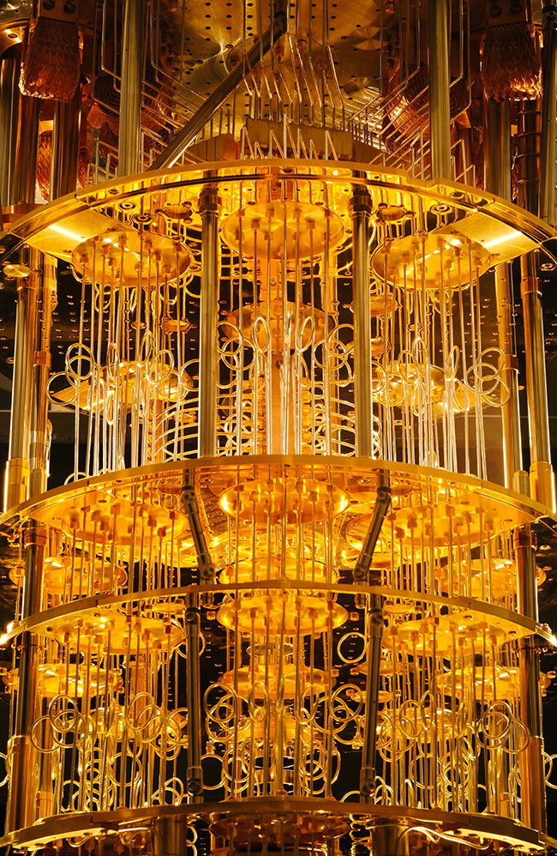
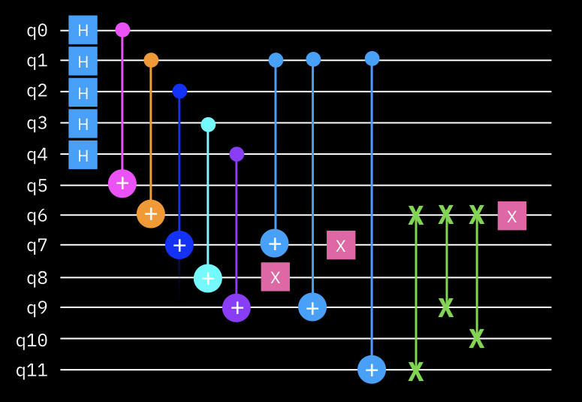
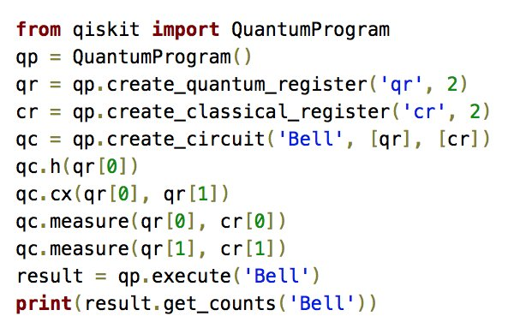
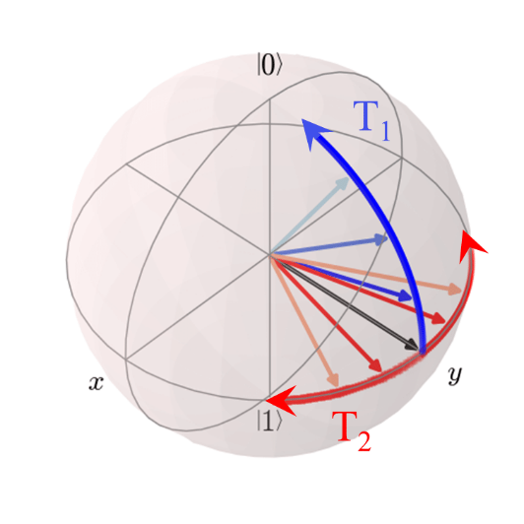

Foundations of
Quantum Computing
(QIS 301)
Dave Biersach
Brookhaven National Laboratory
dbiersach@bnl.gov
Session 04
Introducing Python
(Double Period)

Slide 2
Session Goals
Review the rules for declaring identifiers
Understand statements and scopes
Declare variables and use built-in data types
Display the values of variables in the output terminal
Create simple loops with the for statement
Introduce range() as a "lazy" list definition

Slide 3
Identifiers
Identifiers are just names – everything in code has a name
Names must be < 64 chars in length
They can include upper- or lower-case letters & numbers
Identifiers must start with a letter and cannot contain spaces!
Three types of identifier “casing”
CamelCaseEachWord
camelCaseEachWord
all lower_case with underscores
Identifiers in Python are case sensitive!!
x is not the same as X
Use ALLCAPS to define global constants (very rare)
(first letter is Capitalized)
(first letter is not capitalized)
(Snake case in Python!)
✓

Slide 4
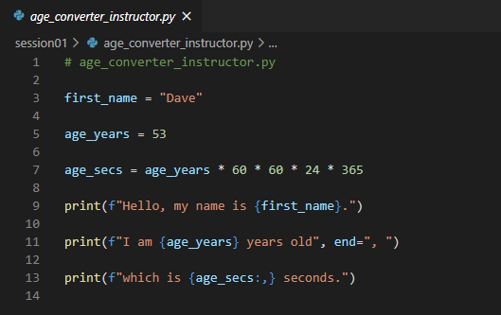
Identifiers
Source code comments start with a #
Variable
Name
Function
Name
An f string
A formatter

Slide 5
Statements & Scopes
A statement does something (think: sentence)
A statement is either a declaration, a keyword, or a function
Statements are executed from top to bottom of a scope
A scope contains one or more statements (think: paragraph)
A scope in Python begins with a colon :
Scopes are denoted via indentation
All the statements in a scope must start at the same column
Scopes can be nested – each inner scope is further indented
Certain Python statements "introduce" (require) a new scope
In Python, white space is significant – indentation matters!

Slide 6
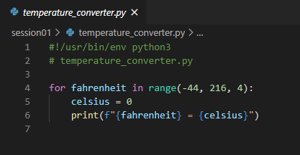
Statements and Scopes
A for loop introduces a scope with a colon :
The statements in a for loop scope are all indented by the same amount
Identifiers live only within the scope in which they are defined
(except for closures)

Slide 7
Variable Types
Variables store data in memory to be used later
Variables can be called whatever you want
Pick variable names that mean something to a human
Use snake_case (all lower case, underscores to break words)
Python supports many built-in data types for variables:
int = Stores integers only
float = Stores real numbers with 15 digits of precision
bool = Stores True or False (Boolean logic)
str = Stores zero or more letters & numbers

Slide 8
Displaying Variables
The print() function is used to display the value of variables
When running inside Visual Studio Code, the print() output will show up in the Python console window at the bottom of screen
String literals must be enclosed in quotation marks (single or double)
Python can substitute a variable's value into a placeholder
To make a placeholder (aka replacement field) you enclose the variable name between curly braces {}
Substituting a variable's actual value into its replacement field is called string interpolation
Placeholders can also contain format specifiers
You can specify number of digits to the right of the decimal, etc.
You can specify left/right/center justification, column width, etc.

Slide 9

print() and f-strings
Placing a lowercase f before the first quote in a print() statement indicates you will use some placeholders
A placeholder contains the variable's name sandwiched between curly braces {}
A colon after the variable's name starts a format specifier

Slide 10
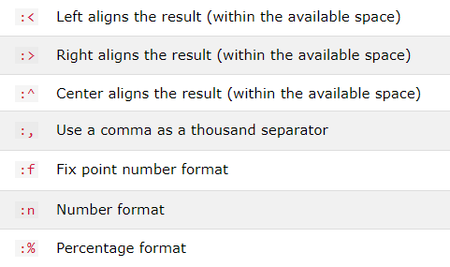
Some Common Format Specifiers
Using format specifiers is optional but makes your output more professional

Slide 11
print() and f-strings
Print the current value of the variable fahrenheit right-justified (>) in a column six characters wide (6) and round to two digits (.2f) to the right of the decimal

Slide 12
Mathematical Operators
Python operators obey normal PEMDAS precedence
Expressions are evaluated left to right in your source code
Use = to assign a value to a variable
Use * for multiplication and / for division operators
Use parenthesis to explicit specify the order of operations
The “greater than or equal to” operator is >=
The “less than or equal to” operator is <=

Slide 13


for loops
A for loop executes all the statements within its scope for each item in the list passed into the for
It is common to use the range() function to describe the list of numbers passed into the for statement
The range() function takes three parameters: (start, stop, step)
The stop value is required but the start and step values are optional
The default value for start is 0 and for step is 1
The range is inclusive, exclusive: [start, stop)
$$⟹$$

Slide 14
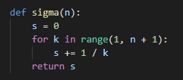
def Statement
The function name
def is how we define a function
Be mindful of the colons : that start the scopes
The inbound parameters
Statements within a scope are indented
Functions can return values

Slide 15
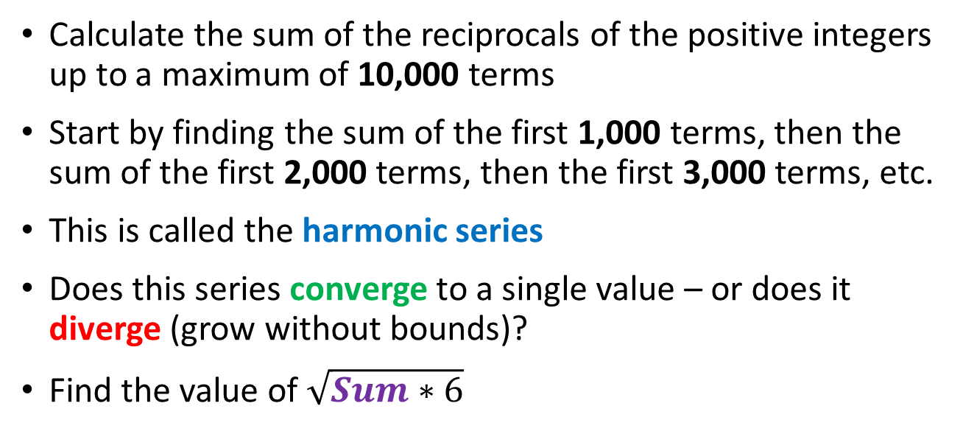
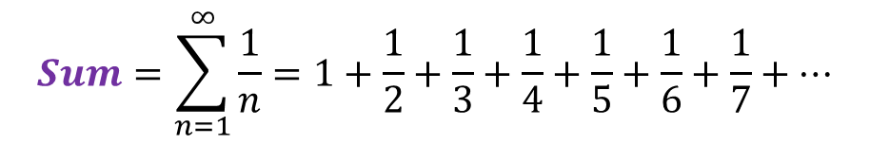
The Basel Problem
$$Sum=\sum_{n=1}^{∞}{\frac{1}{n}=1+\frac{1}{2}+\frac{1}{3}+\frac{1}{4}+\frac{1}{5}+\frac{1}{6}+\frac{1}{7}+…}$$
Calculate the sum of the reciprocals of the positive integers up to a maximum of 10,000 terms
Start by finding the sum of the first 1,000 terms, then the sum of the first 2,000 terms, then the first 3,000 terms, etc.
This is called the harmonic series
Does this series converge to a single value – or does it diverge (grow without bounds)?
Find the value of $\sqrt{Sum∗6}$

Slide 16
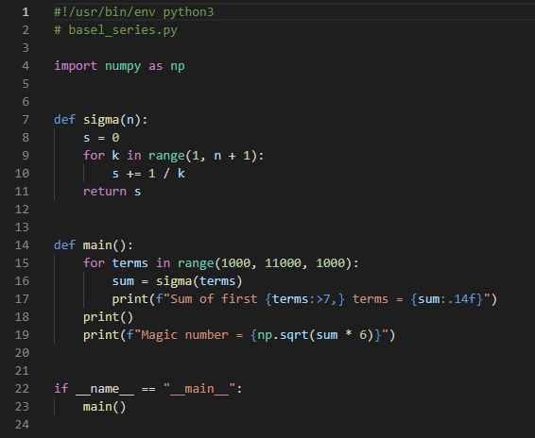
Open basel_series.py
The #! is a "shebang" that allows us to run a Python script right from the command line (terminal/shell)
This tells the Python interpreter to import a package that contains 3rd party modules we can use in our code

Slide 17
View basel_series.py
This tells the Python interpreter what function to call when this script is run (versus being imported by another script)

Slide 18
View basel_series.py
④
⑤
①
②
③
⑥
⑦

Slide 19
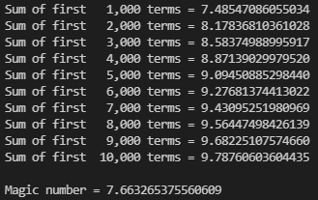
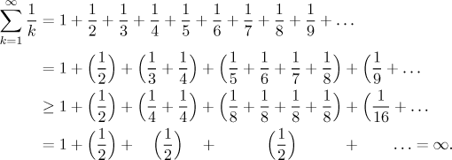
Run basel_series.py
The harmonic series diverges
①

Slide 20
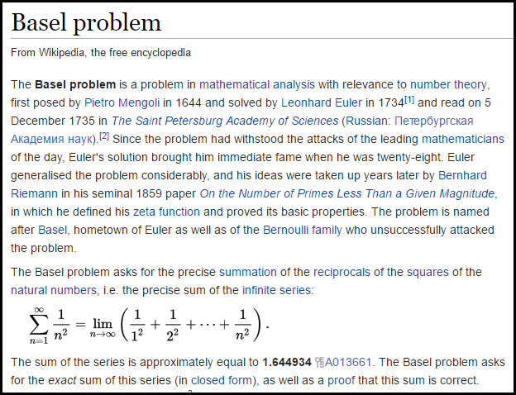

Slide 21
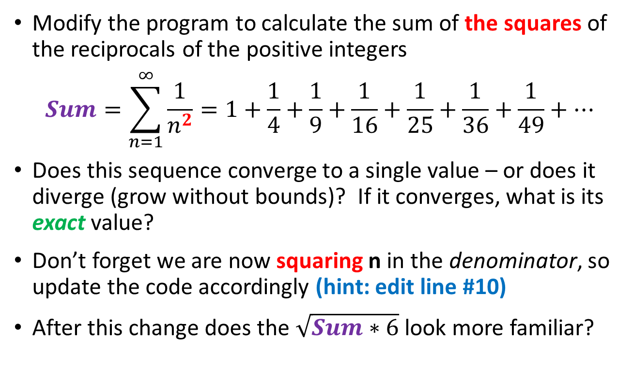
Edit basel_series.py
Modify the program to calculate the sum of the squares of the reciprocals of the positive integers
$$Sum=\sum_{n=1}^{∞}{\frac{1}{n^{2}}=1+\frac{1}{4}+\frac{1}{9}+\frac{1}{16}+\frac{1}{25}+\frac{1}{36}+\frac{1}{49}+…}$$
Does this sequence converge to a single value – or does it diverge (grow without bounds)? If it converges, what is its exact value?
Don’t forget we are now squaring n in the denominator, so update the code accordingly (hint: edit line #10)
After this change does the $\sqrt{Sum∗6}$ look more familiar?

Slide 22

Edit basel_series.py
①

Slide 23
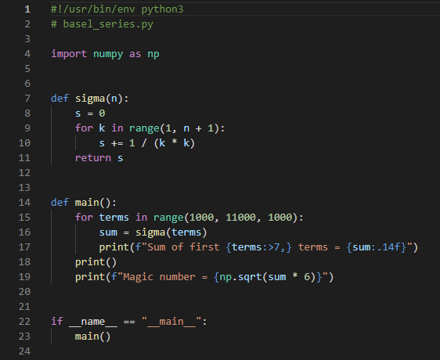
Edit basel_series.py
①

Slide 24
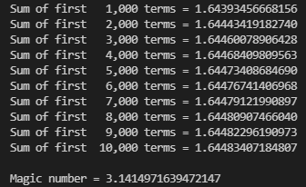
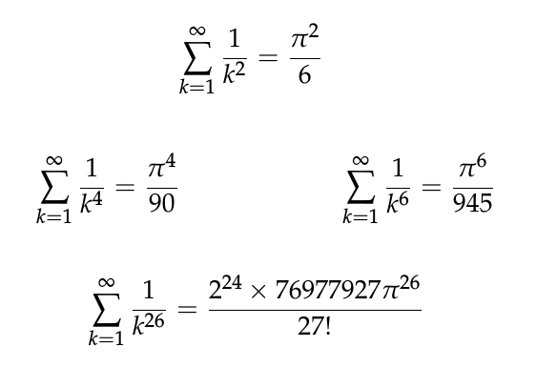
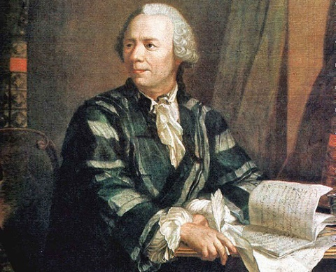
Run basel_series.py
The series converges

Slide 25
if Statement
An if statement identifies which code block (scope) to run based upon the value of a Boolean expression
The expression (the condition) must evaluate to either a True or a False value
If the condition is True, then the scope immediately following the if statement is executed
If the condition is False, and there is an else clause, then the scope immediately following the else statement is executed
Every if statement does not need to have an else clause
You can also use elif to continue to test for other conditions
The if, elif, and else statements all introduce scopes (meaning they require a colon at the end of their line)

Slide 26
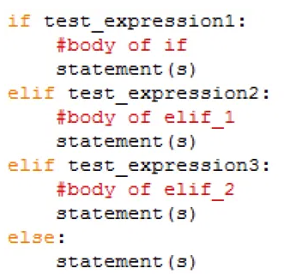
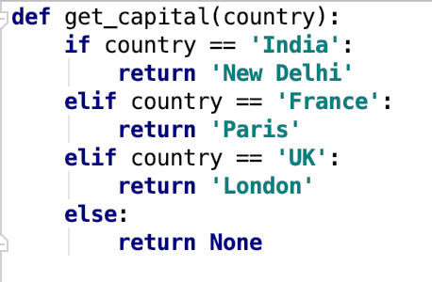
if Statement
def is how we define a function
Functions can return values
Be mindful of the colons : that start the scopes

Slide 27
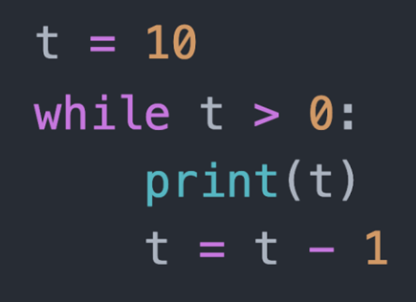
while Loop
A while loop executes all the statements within its scope as long as the loop conditional remains True
The loop conditional
A while loop introduces a scope

Slide 28
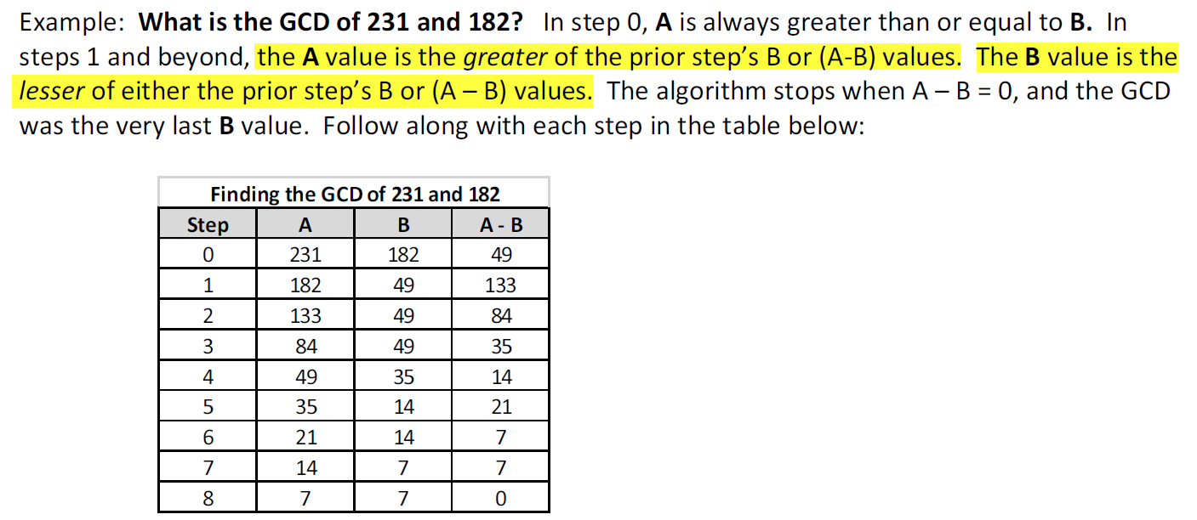
Greatest Common Divisor (GCD)
What divides A and B must also divide the difference of A - B
Why?
Given {A, B, a, b, r} ∊ ℤ
$$A=a ∗r, B=b ∗r$$
$$\left(A −B\right)=a∗r −b ∗r$$
$$a −b= \frac{\left(A −B\right)}{r}$$
∴ One can determine the GCD without having to factor either of the two integers!

Slide 29
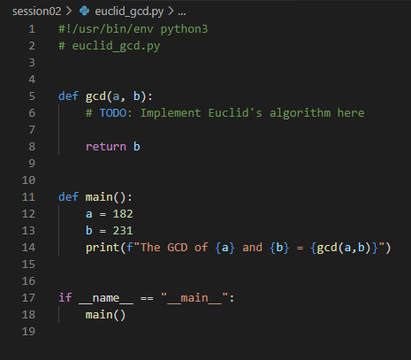
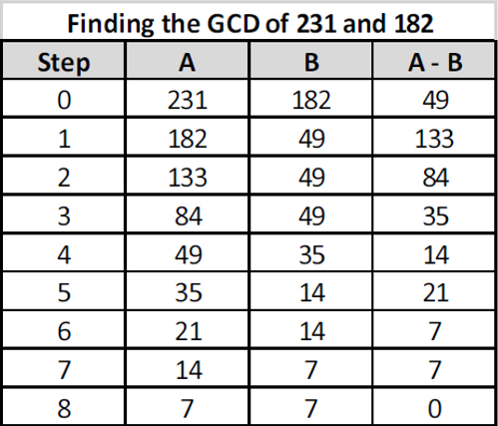
Edit euclid_gcd.py
Ensure $a≥b$

Slide 30
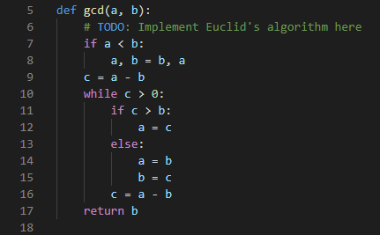
Edit euclid_gcd.py
A convenient way to swap two values
The if statement introduces a scope with the colon :
The while statement introduces a scope with the colon :

Slide 31
Run Lab 2 – Euclid’s GCD
☺

Slide 32
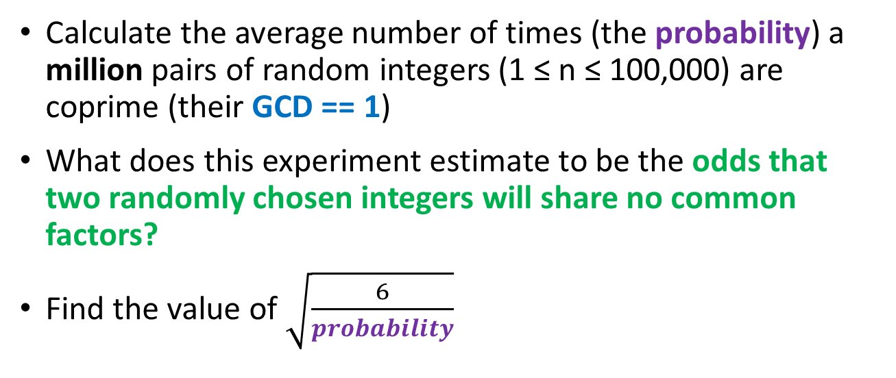
Coprime Probability
Calculate the average number of times (the probability) a million pairs of random integers (1 ≤ n ≤ 100,000) are coprime (their GCD == 1)
What does this experiment estimate to be the odds that two randomly chosen integers will share no common factors?
Find the value of $\sqrt{\frac{6}{probability}}$

Slide 33
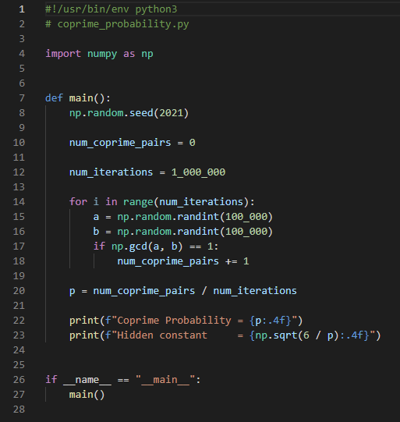
Open coprime_probability.py
①
②
③
④
⑤
⑥
⑦

Slide 34



Run coprime_probability.py
Leonhard Euler
(1707-1783)

Slide 35
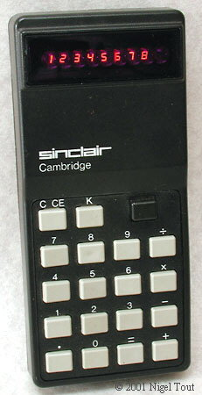
Old School Square Roots
My first calculator back in 1977 could only add, subtract, multiply, and divide
As a 6th grader, I had heard of “Square Roots” and I knew t$hat \sqrt{25}=5$.
But what is $\sqrt{1977}$ ?
How can we find the square root of a number using only the elementary (+, -, *, /) operations?
Newton had solved that 313 years before me!

Slide 36
Old School Square Roots
Newton’s method for calculating the square root of any real x involves keeping track of "low end” and “high end” brackets which get successively closer to the actual root
We start with the lowEnd = 0 and highEnd = x
The process brackets inward keeping ${lowEnd}^{2}≤x≤{highEnd}^{2}$
During each loop iteration, our estimate is the mean of the current lowEnd & the highEnd brackets
Then if the $estimate^{2}$ > x, move highEnd down to estimate
Alternatively, if the $estimate^{2}$ < x, move lowEnd up to estimate
Stop when the $\left|(estimate^{2}−x)\right| ≤ ɛ$

Slide 37
Newton’s Method for $\sqrt{49}$
$$ε=.0003$$
$$\frac{\left(lowEnd+highEnd\right)}{2}$$
highEnd moves down to the estimate
lowEnd
estimate
highEnd
0
24.5
49
$${24.5}^{2}=600.25$$
$$600.25>49$$
The estimate is too high!

Slide 38
Newton’s Method for $\sqrt{49}$
$$ε=.0003$$
$$\frac{\left(lowEnd+highEnd\right)}{2}$$
lowEnd
highEnd
0
12.25
24.5
49
$${12.25}^{2}=150.0625$$
$$150.0625>49$$
The estimate is too high!

Slide 39
Newton’s Method for $\sqrt{49}$
$$ε=.0003$$
$$\frac{\left(lowEnd+highEnd\right)}{2}$$
lowEnd
highEnd
0
6.125
12.25
49
$${6.125}^{2}=37.515$$
$$37.515<49$$
The estimate is too low!
lowEnd moves up to the estimate

Slide 40
Newton’s Method for $\sqrt{49}$
$$ε=.0003$$
$$\frac{\left(lowEnd+highEnd\right)}{2}$$
lowEnd
highEnd
highEnd moves down to the estimate
0
6.125
12.25
49
9.1875
$${9.1875}^{2}=84.410$$
$$84.410>49$$
The estimate is too high!

Slide 41
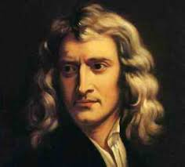
Newton’s Method for $\sqrt{49}$
$$ε=.0003$$
$$\frac{\left(lowEnd+highEnd\right)}{2}$$
lowEnd
highEnd
0
6.125
9.1875
49
7.65625
$${7.65625}^{2}=58.618$$
$$58.618>49$$
With each iteration we are closing in on the $\sqrt{49}=7$
The estimate is too high!
Isaac Newton (1642-1726)

Slide 42
Newton’s Method for $\sqrt{49}$
$$ε=.0003$$

Slide 43
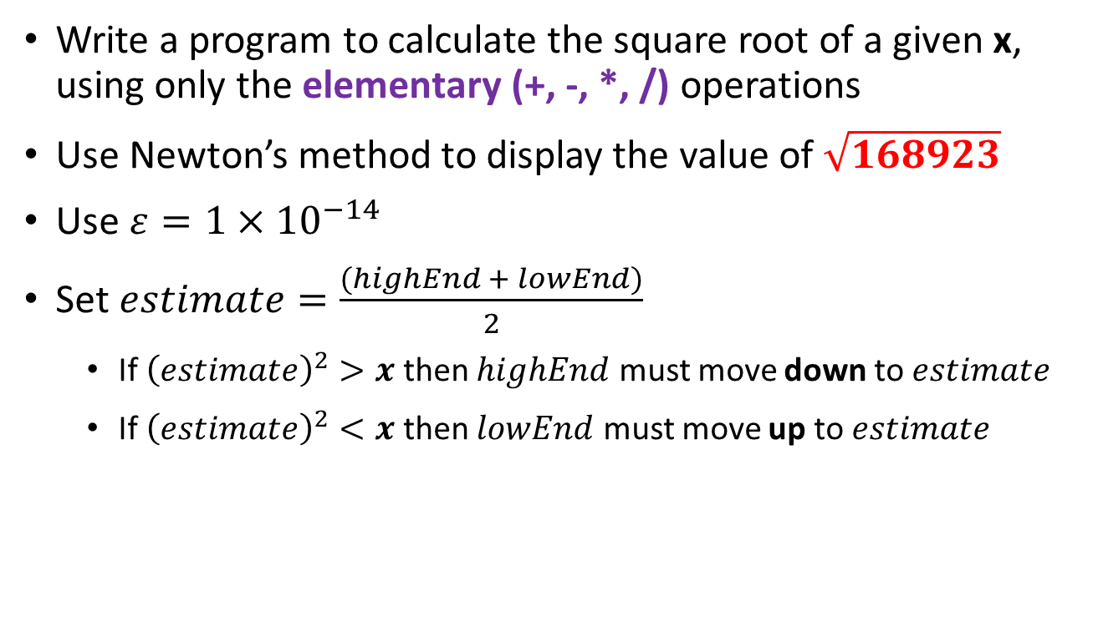
Newton’s Square Root
Write a program to calculate the square root of a given x, using only the elementary (+, -, *, /) operations
Use Newton’s method to display the value of $\sqrt{168923}$
Use $ε=1×{10}^{−14}$
Set $estimate=\frac{(highEnd + lowEnd)}{2}$
If ${\left(estimate\right)}^{2}>x$ then $highEnd$ must move down to $estimate$
If ${\left(estimate\right)}^{2}<x$ then $lowEnd$ must move up to $estimate$

Slide 44
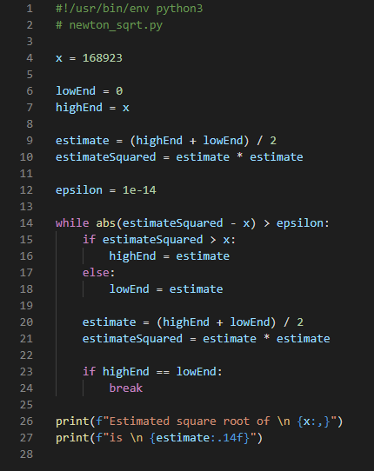

Run newton_sqrt.py
We can use scientific notation to define variables
The built-in abs() function returns the absolute value
The break statement will exit the containing loop immediately

Slide 45
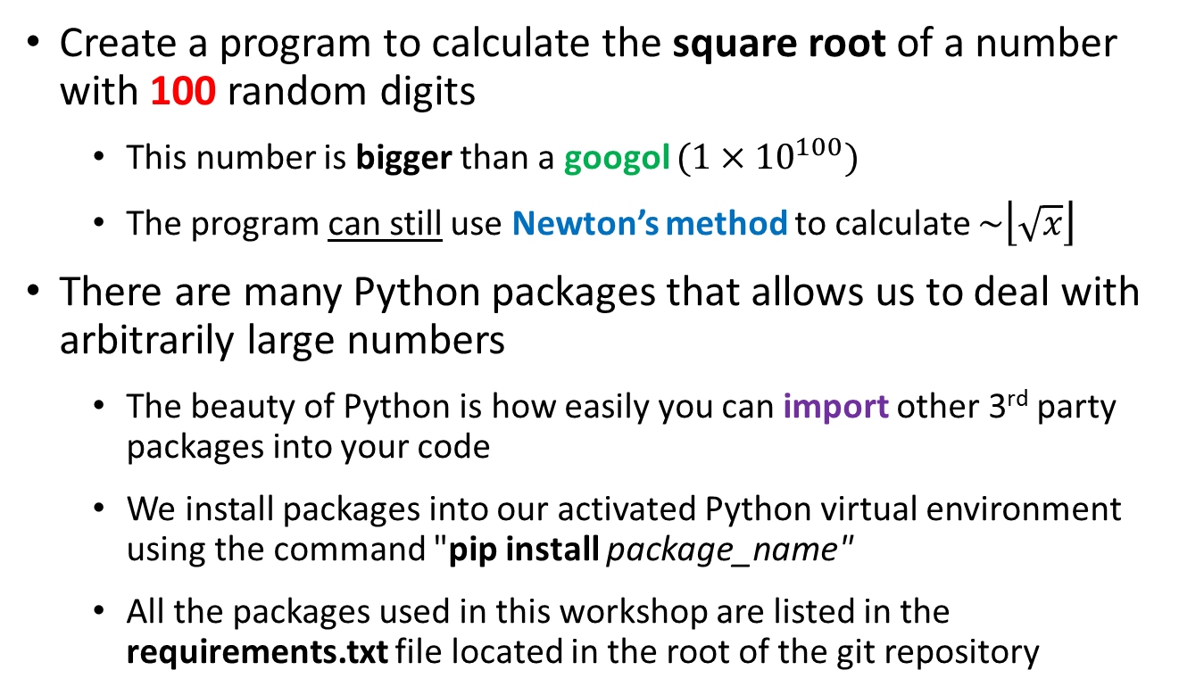
Roots of Googol
Create a program to calculate the square root of a number with 100 random digits
This number is bigger than a googol $(1×{10}^{100})$
The program can still use Newton’s method to calculate $\sim \left\lfloor \sqrt{x}\right\rfloor$
There are many Python packages that allows us to deal with arbitrarily large numbers
The beauty of Python is how easily you can import other 3rd party packages into your code
We install packages into our activated Python virtual environment using the command "pip install package_name"
All the packages used in this workshop are listed in the requirements.txt file located in the root of the git repository

Slide 46
Roots of Googol
A very good package to use for large numbers is mpmath
It provides a "drop-in" replacement for int and float
You don't have to learn a lot of new things to use this package
For more information see https://mpmath.org

Slide 47
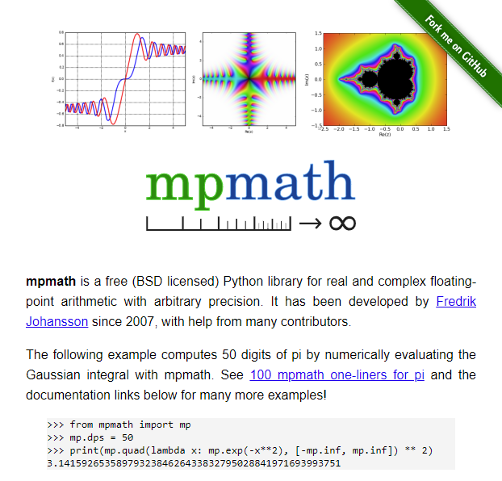
Importing Packages
https://mpmath.org

Slide 48
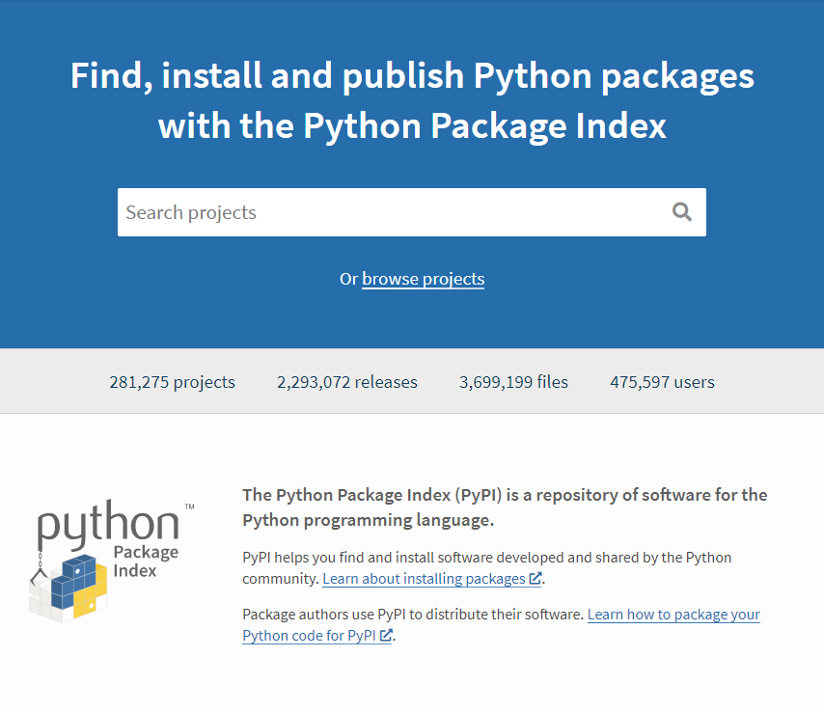
The Python Package Index (PyPI)
https://pypi.org

Slide 49
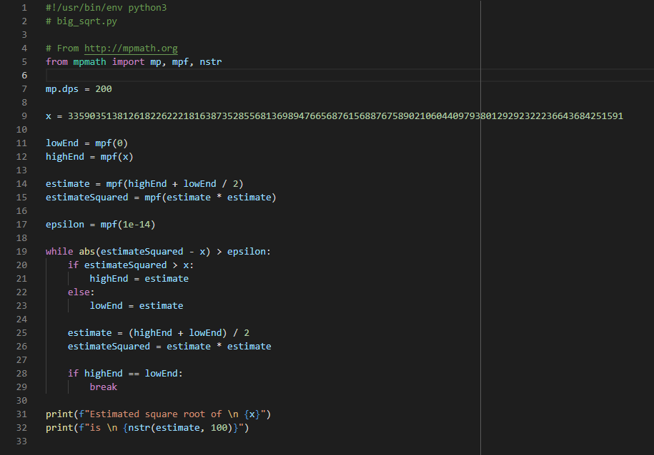
Run big_sqrt.py
Python uses from and import to bring 3rd party packages into your code
We normally don't want our lines to go beyond 80 columns in width
We can still use Newton's method!
☺

Slide 50

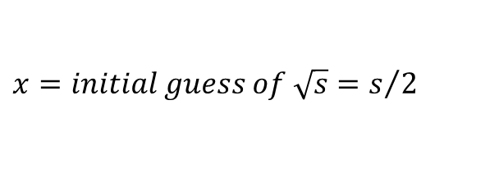
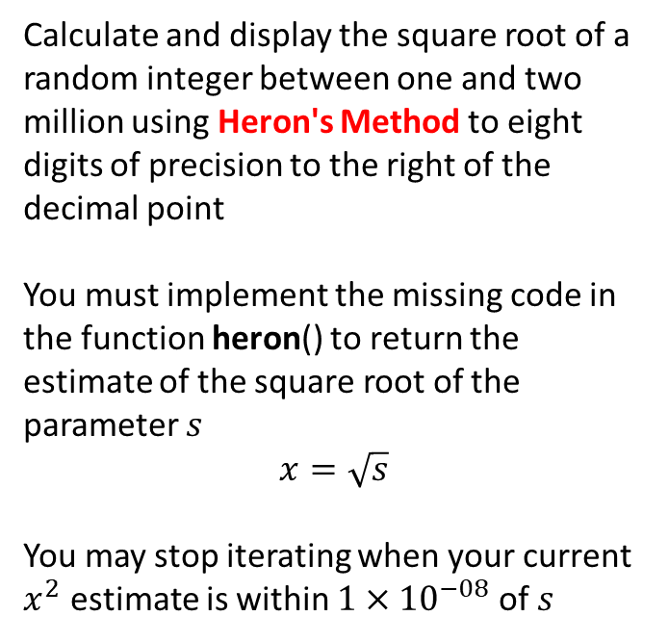
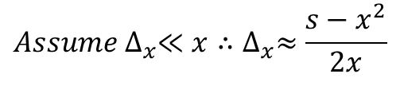

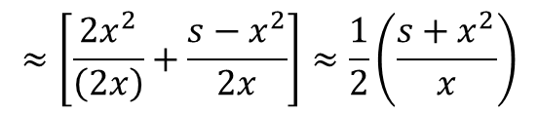

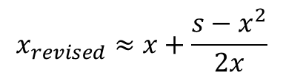
Implement Heron's Method
$$x=initial guess of \sqrt{s}=s/2$$
Calculate and display the square root of a random integer between one and two million using Heron's Method to eight digits of precision to the right of the decimal point
You must implement the missing code in the function heron() to return the estimate of the square root of the parameter $s$
$$x=\sqrt{s}$$
You may stop iterating when your current $x^{2}$ estimate is within ${1×10}^{−08}$ of $s$
$$s={(x+∆_{x})}^{2}=x^{2}+\left(2x\right)∆_{x}+∆_{x}^{2}$$
$$∆_{x}=\frac{s−x^{2}}{2x+∆_{x}}$$
$${Assume ∆}_{x}≪x∴∆_{x}≈\frac{s−x^{2}}{2x}$$
$$x_{revised}=x+∆_{x}$$
$$x_{revised}≈x+\frac{s−x^{2}}{2x}$$
$$≈\left[\frac{{2x}^{2}}{\left(2x\right)}+\frac{s−x^{2}}{2x}\right]≈\frac{1}{2}\left(\frac{s+x^{2}}{x}\right)$$
$$x_{revised}≈Mean\left(\frac{s}{x},x\right)$$

Slide 51
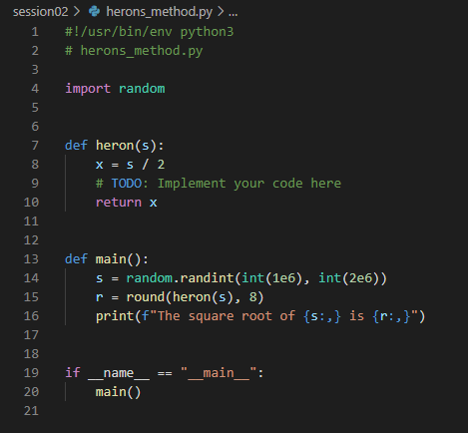

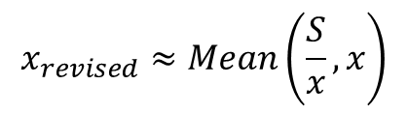
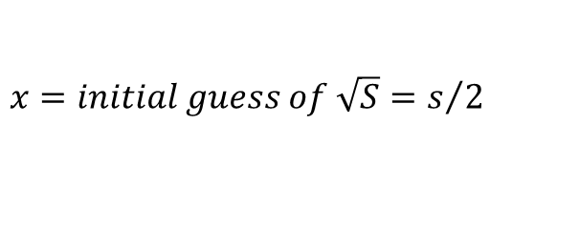
Edit herons_method.py
$$x=initial guess of \sqrt{S}=s/2$$
$$x_{revised}≈Mean\left(\frac{S}{x},x\right)$$
$$ε={10}^{−8}$$

Slide 52
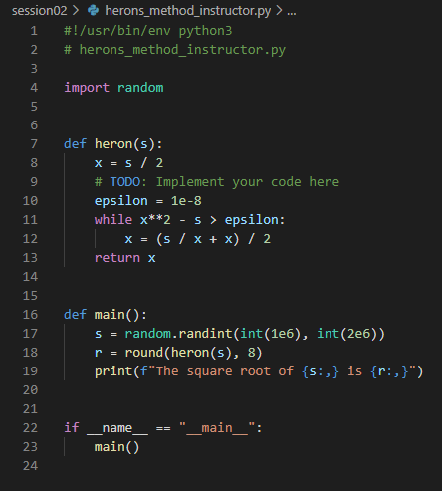

Run herons_method.py
$$x=initial guess of \sqrt{S}=s/2$$
$$x_{revised}≈Mean\left(\frac{S}{x},x\right)$$
$$x∗∗2=x^{2}$$
$$ε={10}^{−8}$$
☺

Slide 53

Random Straws
Write a program to perform ten million runs of an experiment that places a varying number of straws end-to-end each run
In each run, start with a single straw of random length between 0 < n < 1
Then enter a loop that keeps adding additional straws of random length (0 < n < 1) until the total length is > 1
Find the mean number of straws added before the total length > 1, across all ten million runs of the experiment

Slide 54
Random Straws
0.63
1.0
0.89
Straws
0.13
0.89
0.63
1
0.13
0.45
2
0.13
0.76
Run # 1
3
1.21
1
0.13
Run # 2
2
1.02
0.13
0.76
1
0.13
0.07
0.25
2
0.13
0.20
Run # 3
0.07
3
0.13
0.25
0.45
0.07
4
1.21

Slide 55
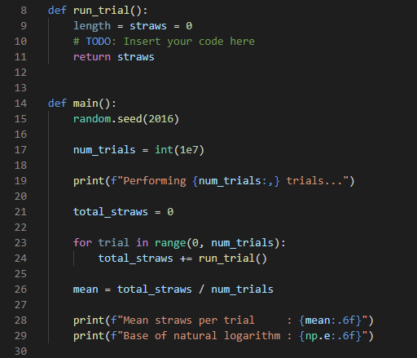
Open random_straws.py
⑤
⑥
①
②
③
④
⑦

Slide 56
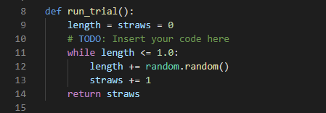

Edit random_straws.py
https://docs.python.org/3/library/random.html

Slide 57

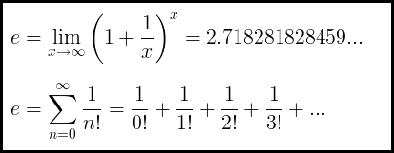
Run random_straws.py

Slide 58
Python vs Java/C++
Python is a dynamically typed language
It is not necessary to declare the type of a variable before assigning a value to it, and a variable can change its type within a scope
In Python, a variable doesn't hold anything – a variable name is just a label for a static value
Function names are normally followed by parenthesis ()
Both functions and statements can introduce scopes using a colon :
Python is whitespace sensitive!
A scope is not enclosed in curly braces {} like in Java/C++
Horizontal indentation is how you denote scopes in Python
All statements sharing the same scope must be vertically aligned

Slide 59
Python vs Java/C++
Python is an interpreted language, not normally compiled
The reference implement of Python is CPython, which is a Python interpreter written in C
Python does not use a classical static linker – you can easily call external code residing in external modules/packages on-the-fly
Python code is inherently more functional (declarative) than procedural (imperative) like Java/C++
With procedural languages you must tell the computer step-by-step how exactly to accomplish what you want
With functional languages you tell the computer what you want to accomplish, and it determines the best way to satisfy your request

Slide 60
Now you know…
How to define variables in Python (snake_case)
How to use print() to show variable values on screen
How to use f-strings with {} placeholders (replacement fields) for variable names
How to indicate format specifiers in order to make your code output more human readable and professional looking
How to define an iterable sequence using range()
How to pass the lazy list generated by range() into the for statement to enumerate each value in that sequence
Python uses the "inclusive/exclusive" paradigm constantly

